Slide 1
Openshift Learning
- Sowmya

Slide 2
Application can be created or deployed into Openshift cluster using various ways
GitHub(Using S2i image builder)
Docker images
Template (YAML)
Developer Catalog
Container image

Slide 3
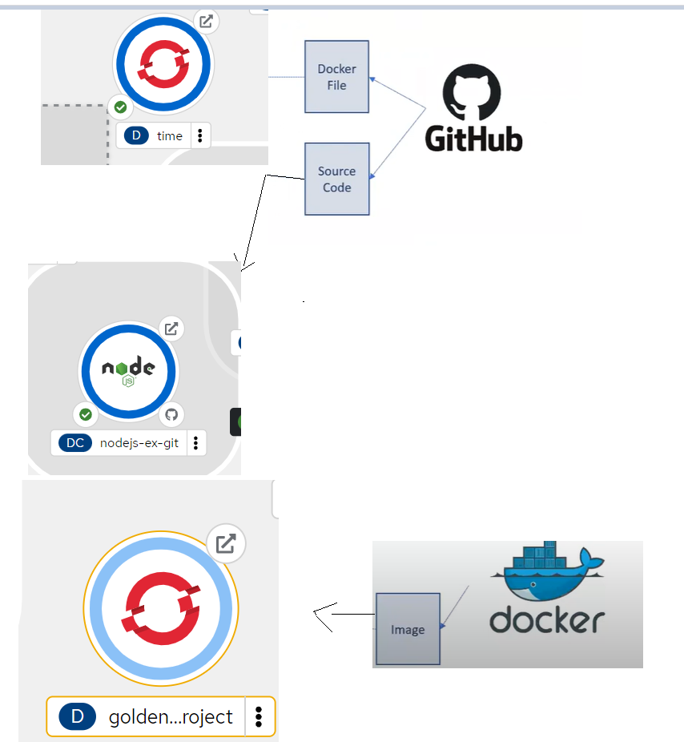

Slide 4
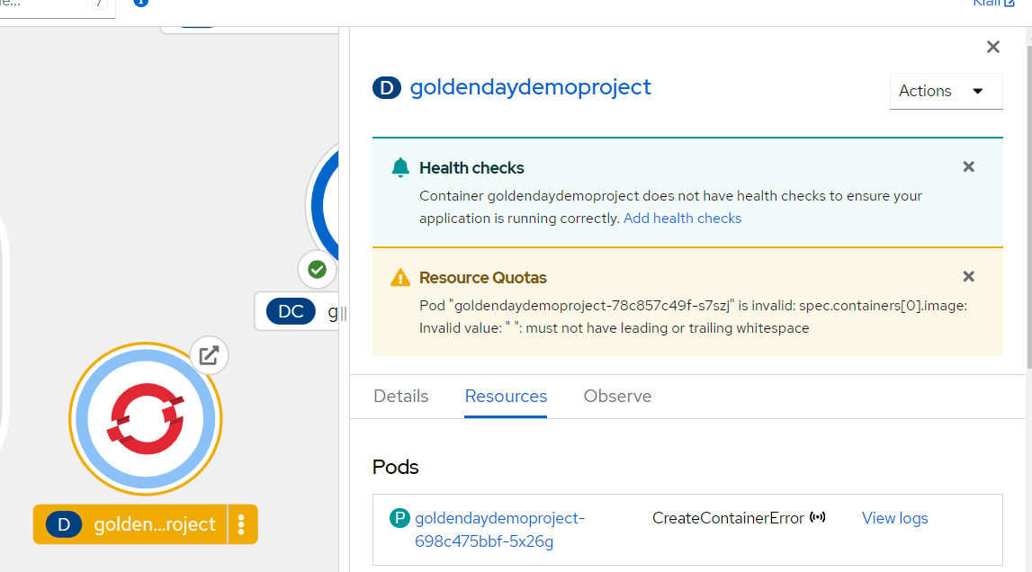
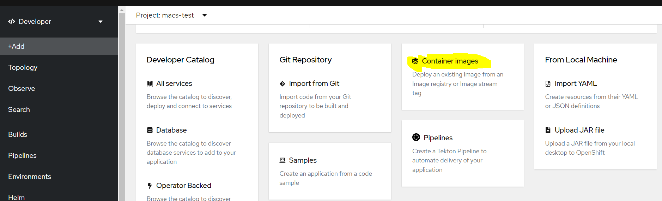
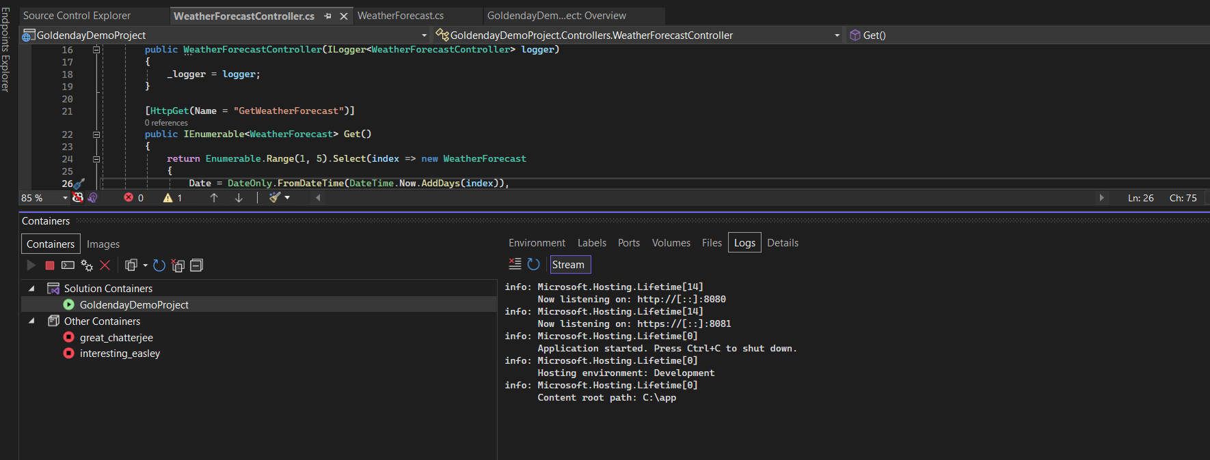
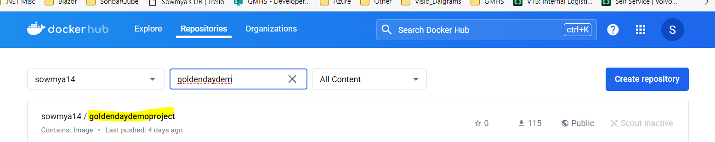
Docker image through web console
https://goldendaydemoproject-macs-test.apps.aro-delta.euw-hub02.azure.volvo.net/

Slide 5
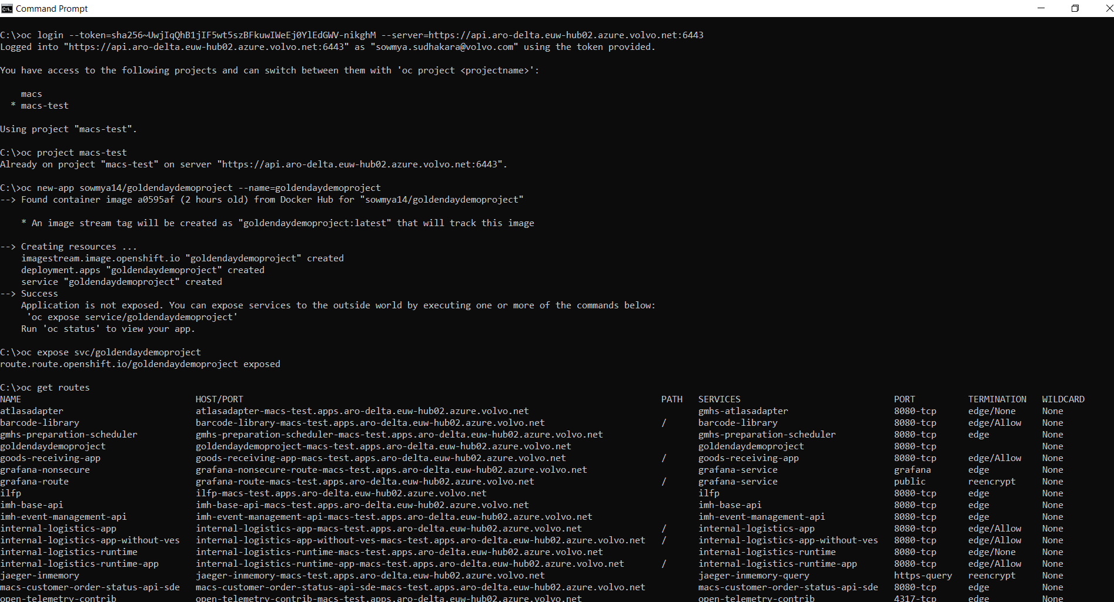
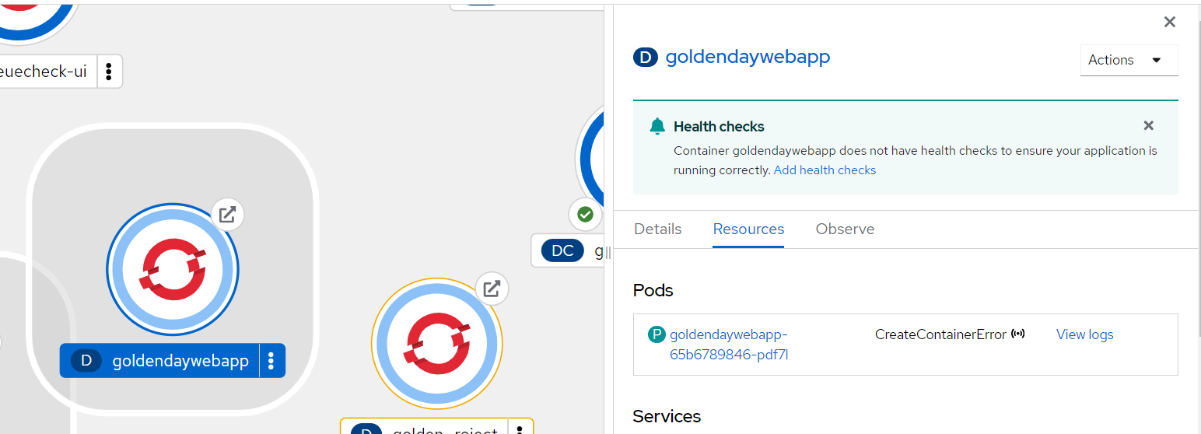
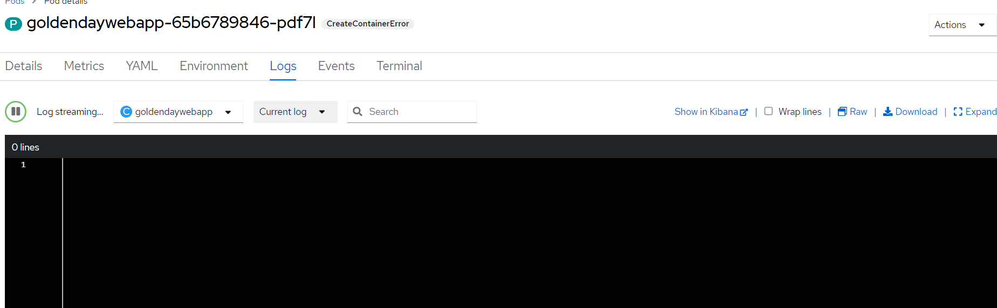
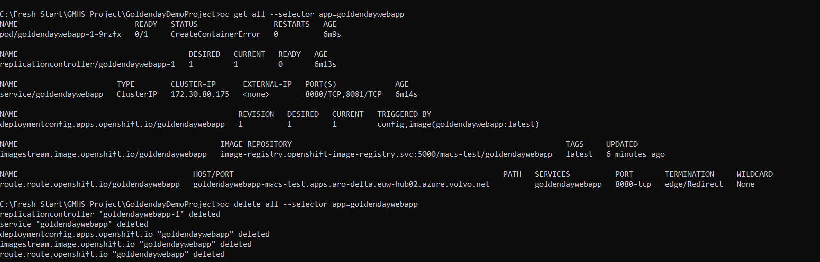
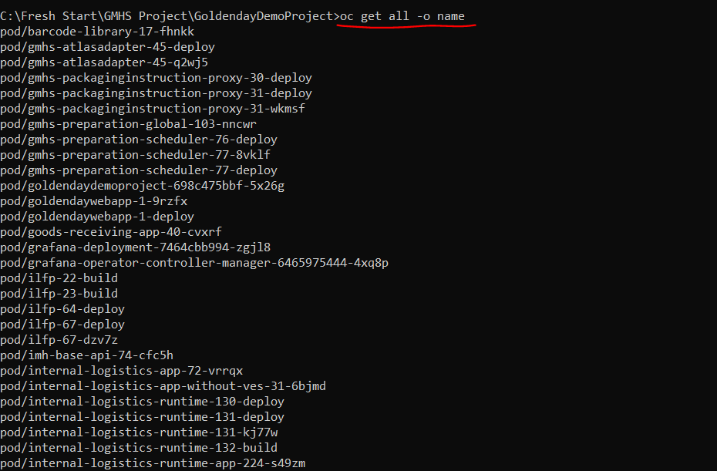
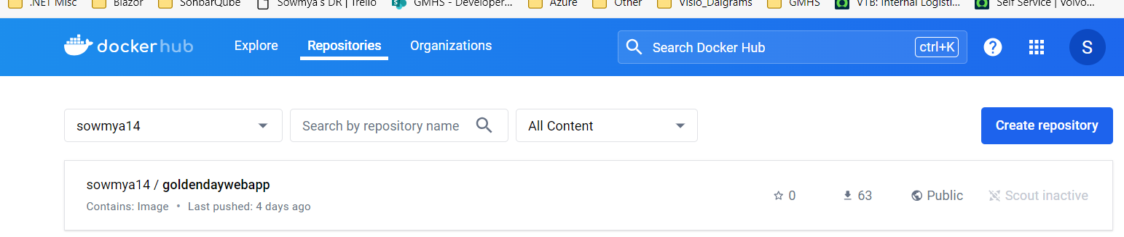
Docker image through command line(oc command)

Slide 6
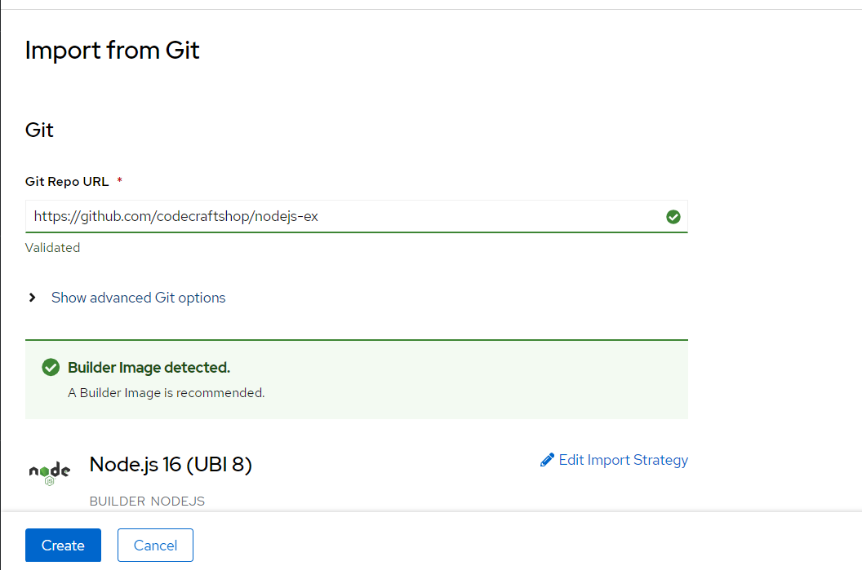
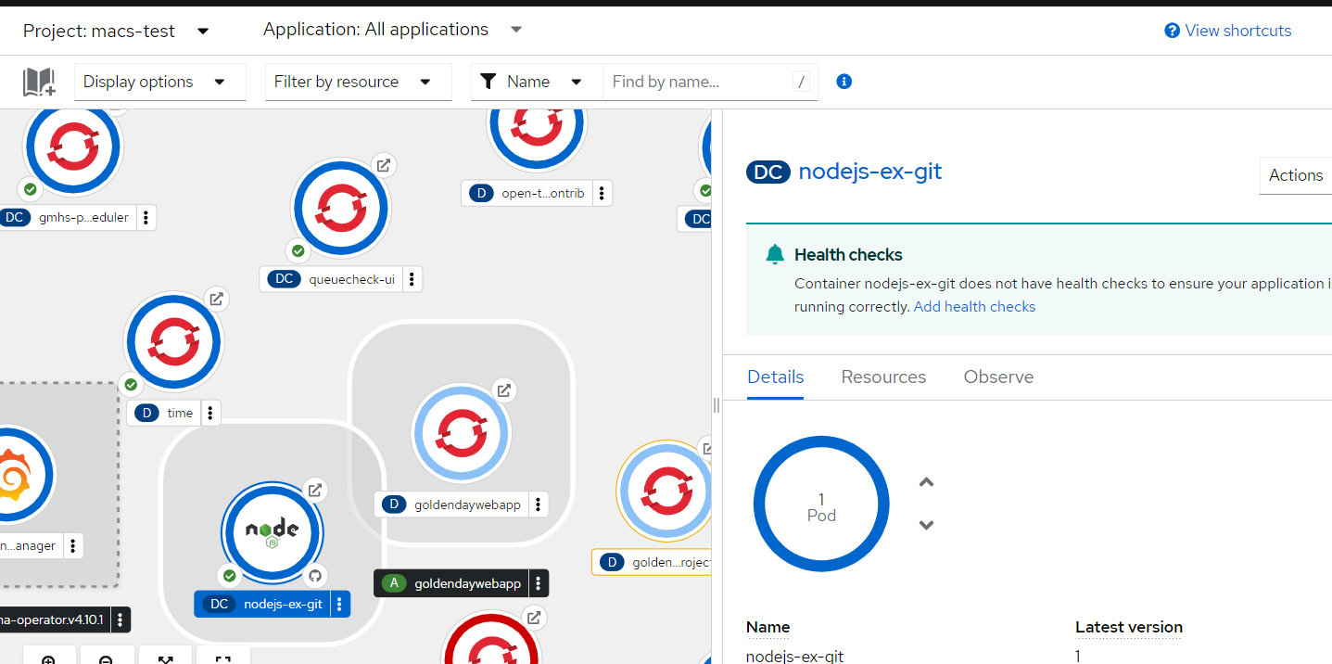
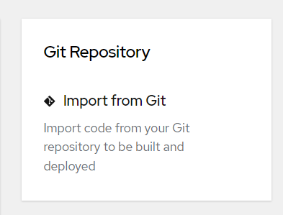
Build Configuration Strategy Source to Image (S2I) & Dockerfile
https://nodejs-ex-git-macs-test.apps.aro-delta.euw-hub02.azure.volvo.net/

Slide 7
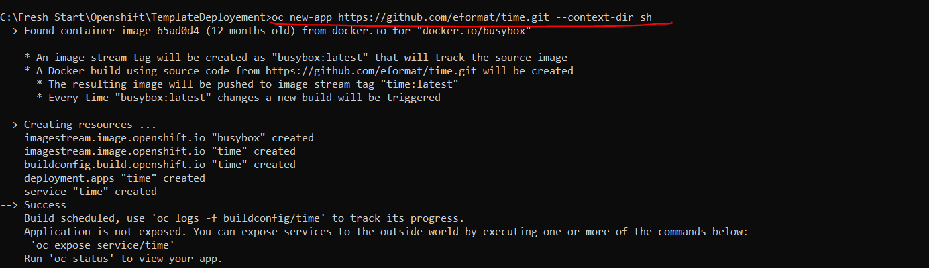
Docker file via command line
Docker Build: When OpenShift finds a Dockerfile in the source, it uses this Dockerfile as the basis to create a docker image for your application.

Slide 8
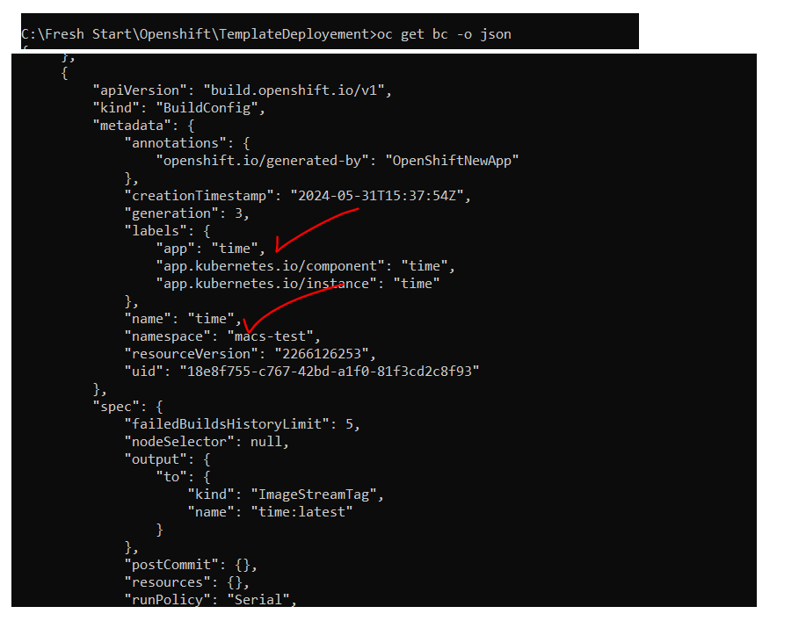

A build was created and scheduled - you can also run oc start-build time to start another build manually.
In the meanwhile lets have a look at the buildconfig by running the command shown below.

Slide 9
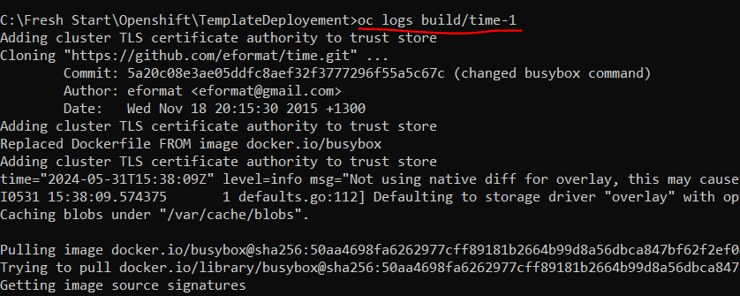
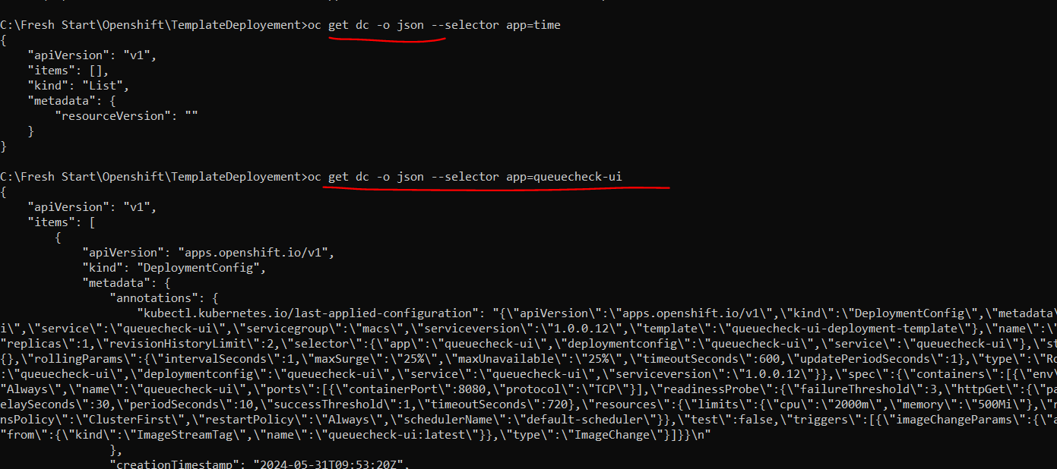
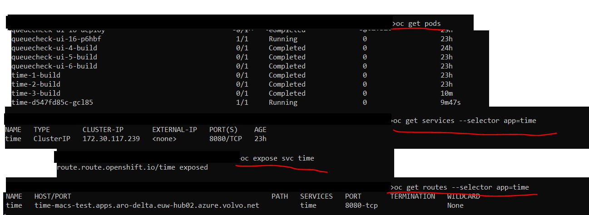
You can view the list of builds using oc get builds also the logs
Once the image is pushed to the docker registry, OpenShift will trigger a deploy process. Let us also quickly look at the deployment configuration by running the following command. Note dc represents deploymentconfig.

Slide 10
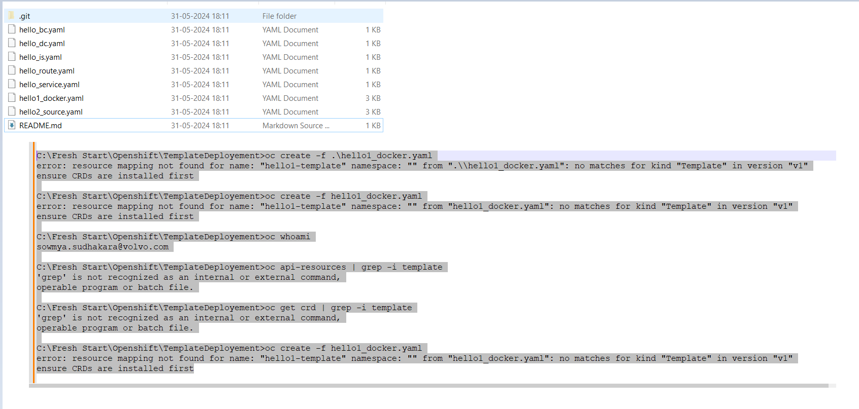
Openshift Template

Slide 11
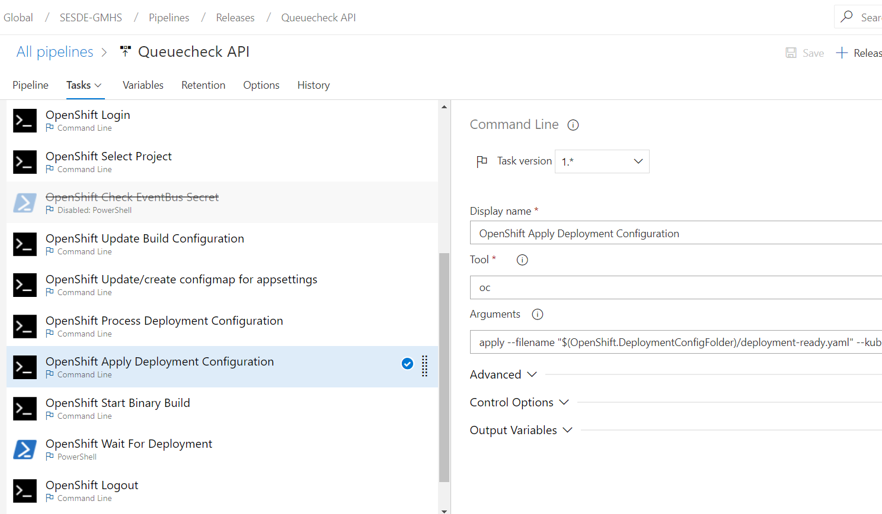
Sample Release pipeline with Openshift tasks

Slide 12
Thank You

